Slide 1


UPPER WILLAMETTE RIVER SPRING CHINOOK ABUNDANCE, DISTRIBUTION AND SURVIVAL
DRAFT Do Not Distribute
Cameron Sharpe and Ben Clemens
Oregon Department of Fish and Wildlife
Willamette BiOp Science Review
February 2015

Slide 2
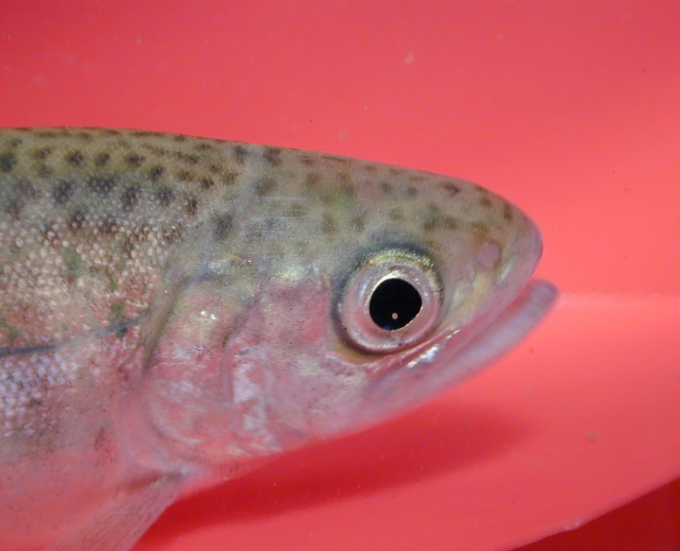
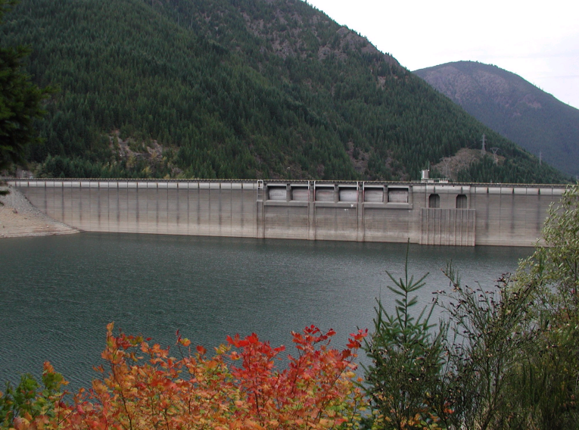
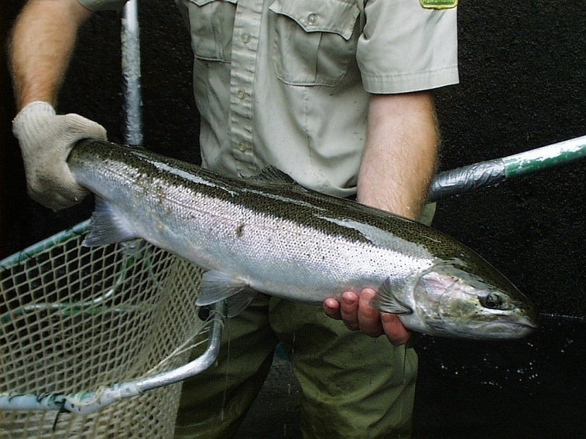


Willamette Biological Opinion Hatchery Research, Monitoring, and Evaluation

Slide 3
Acknowledgments
Funding: US Army Corps of Engineers and Federal Sport Fish Restoration Fund
Field Staff:
Paul Olmsted
Dave Hewlett
Sara Akins
Naomi Halpern
Justin Huff
Kevin Stertz
Chris Abbes
Amy Anderson
Chas Chamberlain
Nick Swofford
Katura Soule
Mariah McIntosh
Administrative/ Technical Support:
Tom Friesen
Marc Johnson
Luke Whitman
Brian Cannon
Bart DeBow
Mike Sinnott
Mike Hogansen
Reed Fischer
JD Hansen
Chris Mayes
Gordon Rose
Keenan Smith
David Metz
Andrew Nordick
Eric Bailey
Hatchery Managers:
Greg Grenbemer
Brett Boyd
Kurt Kremers
Dan Peck

Slide 4
VSP Monitoring Guidelines (Crawford and Rumsey 2011)
Adult Spawner Abundance and Productivity
Spatial Distribution
Species Diversity

Slide 5
REDDS
DEADS
AUGUST: SPAWNING COMMENCES
PROCESSABLE CARCASSES/REACH
CLIPPED
UNCLIPPED
SEPTEMBER: REDDS ACCUMULATE, PEAK SPAWNING LATE
OTOLITHS
OCTOBER: SPAWNING ENDS, PEAK COUNT OBTAINED
NO THERMAL MARKS
THERMAL MARKS
SPAWNER ABUNDANCE (N_{T}) = PEAK COUNT/REACH * 2.5
HATCHERY-ORIGIN (H)
NATURAL-ORIGIN (W)
N_{W} =
N * (1 – pHOS)
N_{H} =
N_{T} * pHOS
pHOS = H/(H + W)

Slide 6
Prespawning Mortality (PSM)
CARCASSES
FEMALES
MALES
???
% EGGS REMAINING
> 50%: PSM
< 50%: SPAWNER
0-20%: LOW; 20-50%: MODERATE; >50%: HIGH

Slide 7
ITM Reach | Peak Redd Count |  | Carcasses |  |  | 2013 OTO Mark |  | Estimated H & W Carcasses |  |  |  | Estimated Spawner Abundance |  |  | PSM
 |  |  | CL | UNCL |  | % |  | H | W | pHOS |  | NOS | HOS |  | SP | UNSP | %
Below Minto | 404 |  | 136 | 87 |  | 8.2% |  | 143 | 80 | 64% |  | 362 | 648 |  | 87 | 38 | 30%
Minto - Big Cliff | 80 |  | 0 | 11 |  | 8.2% |  | 1 | 10 | 8% |  | 184 | 16 |  | 6 | 1 | 14%
Breitenbush | 79 |  | 68 | 0 |  | 8.2% |  | 68 | 0 | 100% |  | 0 | 198 |  | 31 | 1 | 3%
NSNT Above Detroit | 119 |  | 141 | 1 |  | 8.2% |  | 141 | 1 | 99% |  | 2 | 296 |  | 46 | 5 | 10%
Below Foster | 551 |  | 106 | 150 |  | 7.6% |  | 117 | 139 | 46% |  | 746 | 632 |  | 127 | 34 | 21%
SSNT Above Foster | 62 |  | 0 | 63 |  | 7.6% |  | 5 | 58 | 8% |  | 143 | 12 |  | 20 | 9 | 31%
Below Leaburg | 187 |  | 144 | 33 |  | 19.0% |  | 150 | 27 | 85% |  | 71 | 397 |  | 69 | 26 | 27%
Leaburg - Cougar | 297 |  | 38 | 66 |  | 5.2% |  | 41 | 63 | 40% |  | 447 | 296 |  | 58 | 1 | 2%
Abv SFM | 237 |  | 5 | 23 |  | 5.2% |  | 6 | 22 | 22% |  | 461 | 131 |  | 13 | 0 | 0%
SFM Abv Cougar | 248 |  | 32 | 4 |  | 5.2% |  | 32 | 4 | 89% |  | 65 | 555 |  | 20 | 0 | 0%
Below Dexter | 25 |  | 56 | 51 |  | 14.2% |  | 63 | 44 | 59% |  | 26 | 37 |  | 7 | 41 | 85%
Fall Cr | 24 |  | 3 | 29 |  | 0.0% |  | 3 | 29 | 9% |  | 54 | 6 |  | 5 | 12 | 71%
NFMF | 140 |  | 80 | 1 |  | 14.2% |  | 80 | 1 | 99% |  | 4 | 346 |  | 84 | 10 | 11%
Above Hills Cr | 83 |  | 105 | 4 |  | 14.2% |  | 106 | 3 | 97% |  | 7 | 201 |  | 5 | 56 | 92%

Slide 8
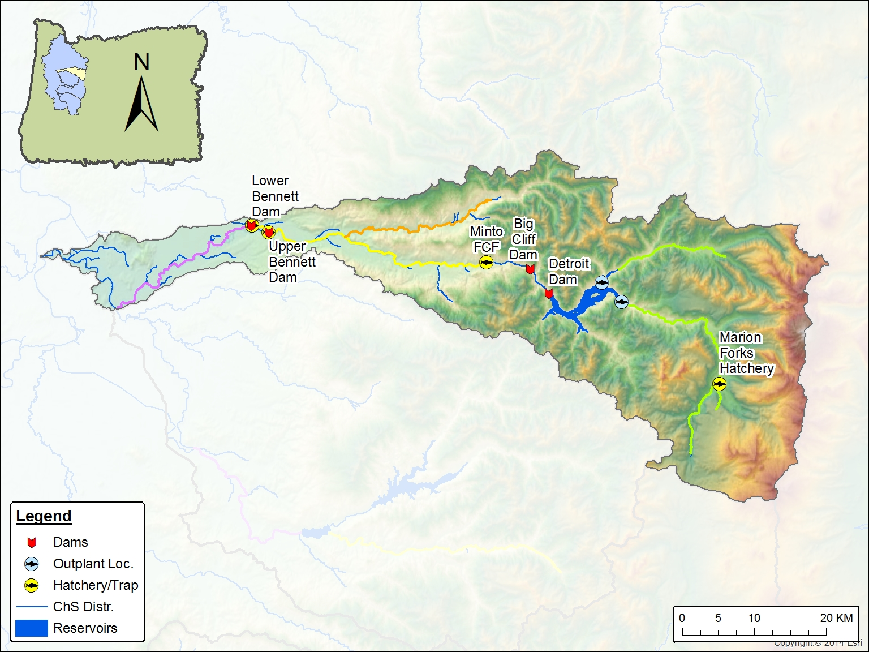
Minto to Big Cliff
Redds: 80
PSM: NA
pHOS: 0% (0/11)
Bennett to Minto
Redds: 398
PSM: 30% (38/127)
pHOS: 64%
Breitenbush
Redds: 79
PSM: 3% (1/31)
pHOS: 100% (68/68)
Below Bennett Redds: 6
PSM: 100% (5/5)
pHOS: 88% (7/8)
Upper N Santiam
Redds: 119
PSM: 10% (5/51)
pHOS: 99% (141/142)

Slide 11
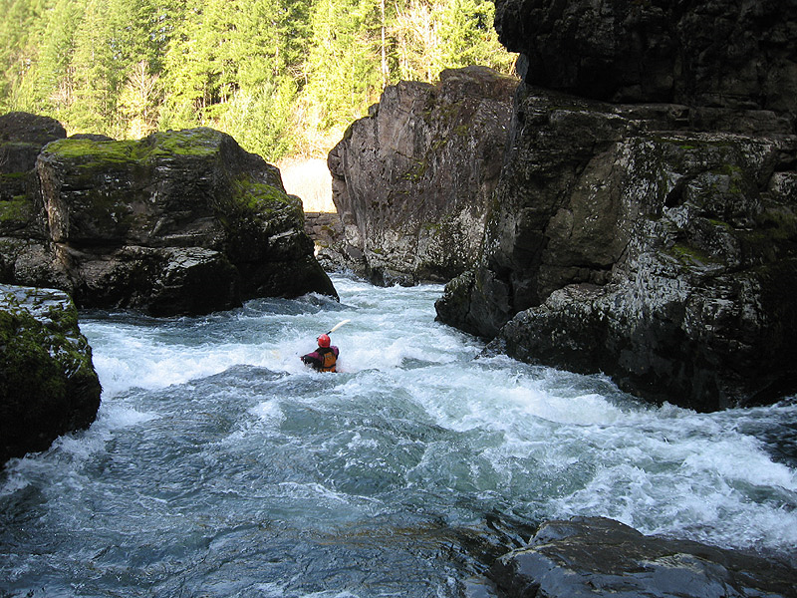
P. Giordano oregonkayaking.net

Slide 12
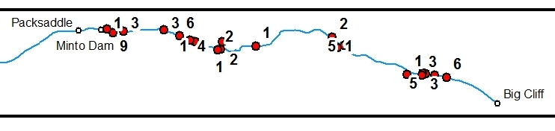
2014 Maiden Voyage
“Peak” Count 80 Redds on Sept 24
“Lots of live fish still”
No subsequent surveys possible

Slide 13
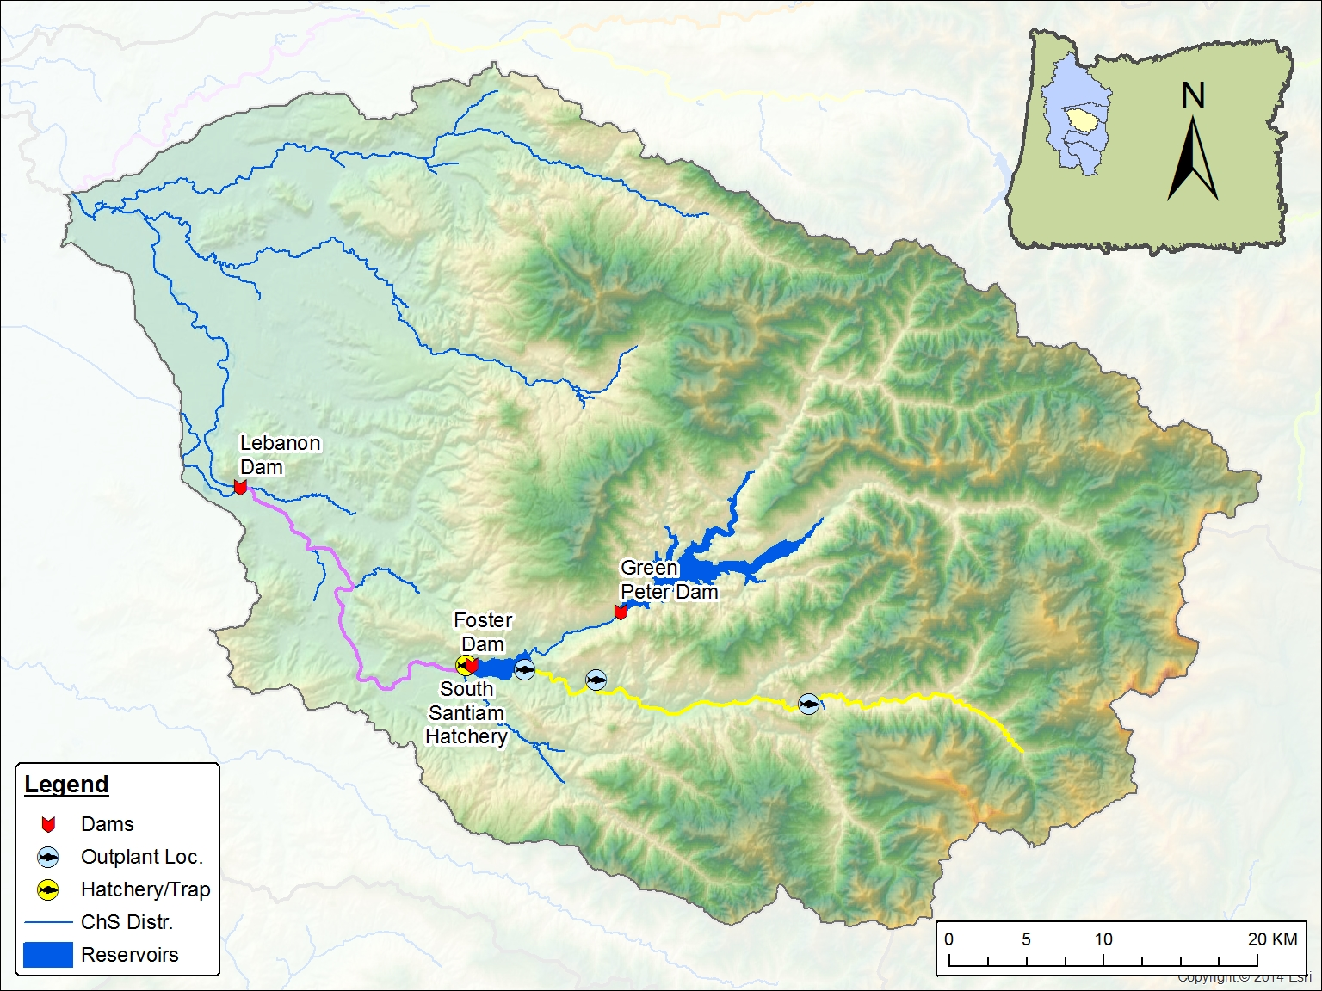
Lebanon to Foster
Redds: 551
PSM: 21% (34/161)
pHOS: 46% (117/256)
Above Foster
Redds: 62
PSM: 31% (9/29)
pHOS: 8% (5/63)

Slide 16
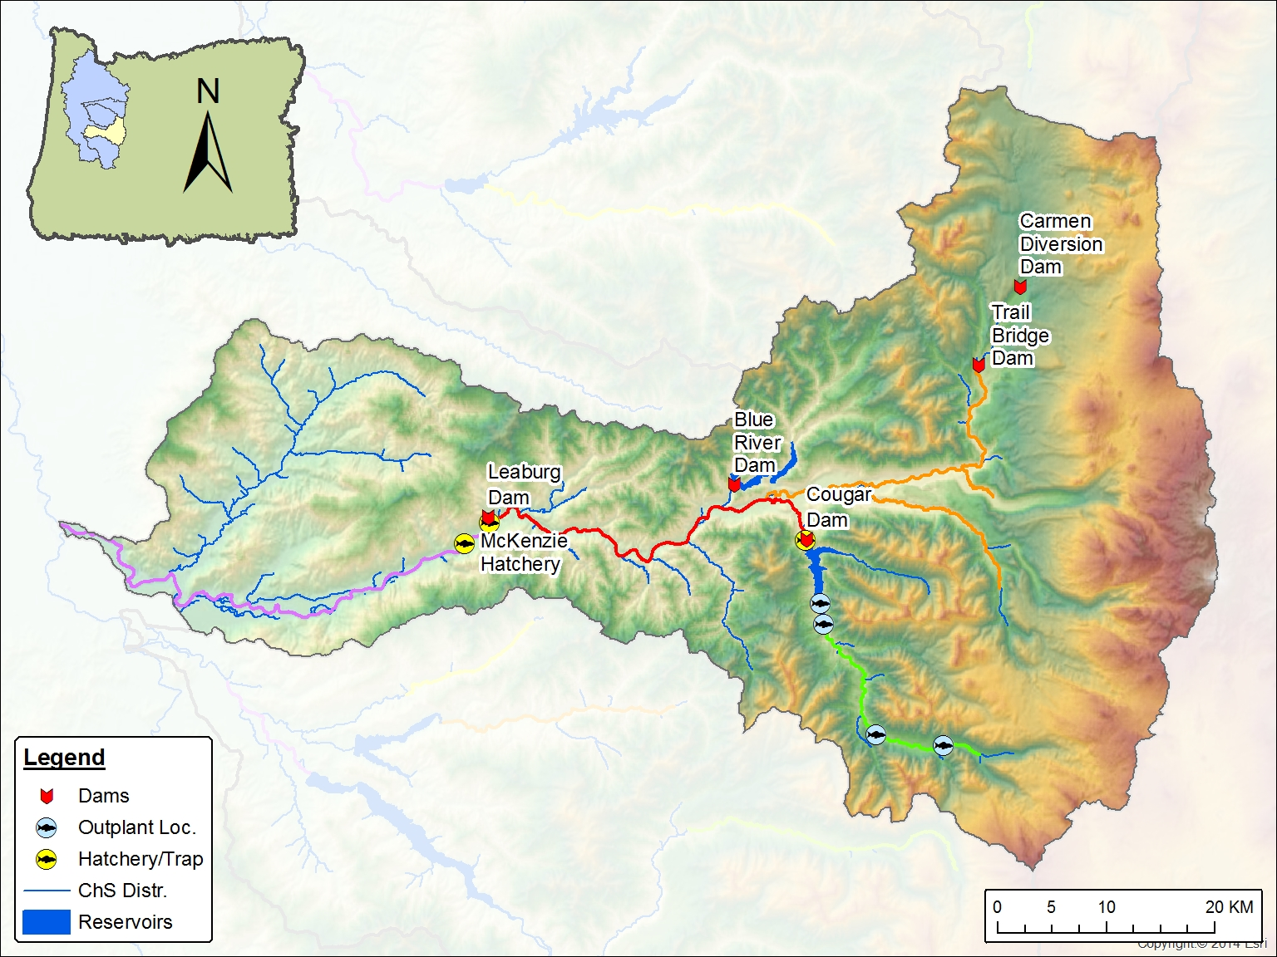
Above S Fk McKenzie
Redds: 237
PSM: 0% (0/13)
pHOS: 22% (6/28)
Below Leaburg
Redds: 187
PSM: 27% (26/95)
pHOS: 85% (150/177)
Above Cougar
Redds: 248
PSM: 0% (0/20)
pHOS: 89% (32/36)
Leaburg to Cougar
Redds: 297
PSM: 2% (1/59)
pHOS: 40% (41/104)

Slide 19
COAST FORK WILLAMETTE RELEASES
Release Location | # Released | SGS Recovery | Hatchery Recovery | Fishery CWT Recovery
McKenzie R. | 243,994 | 23 | 492 | 67
Coast Fork | 211,353 | 4 | 78 | 23

Slide 20
 |  | MCK | CFW
Spawning Ground Surveys | OBS | 23 | 4 |  | G(adj) | 11.97
 | EXP* | 14 | 13 |  | P-value | 0.001
Hatchery Sampling | OBS | 492 | 78 |  | G(adj) | 278.35
 | EXP* | 305 | 265 |  | P-value | 0.000
Fishery Sampling | OBS | 67 | 23 |  | G(adj) | 16.52
 | EXP* | 48 | 42 |  | P-value | 0.000
*Expected based on smolt numbers released

Slide 21
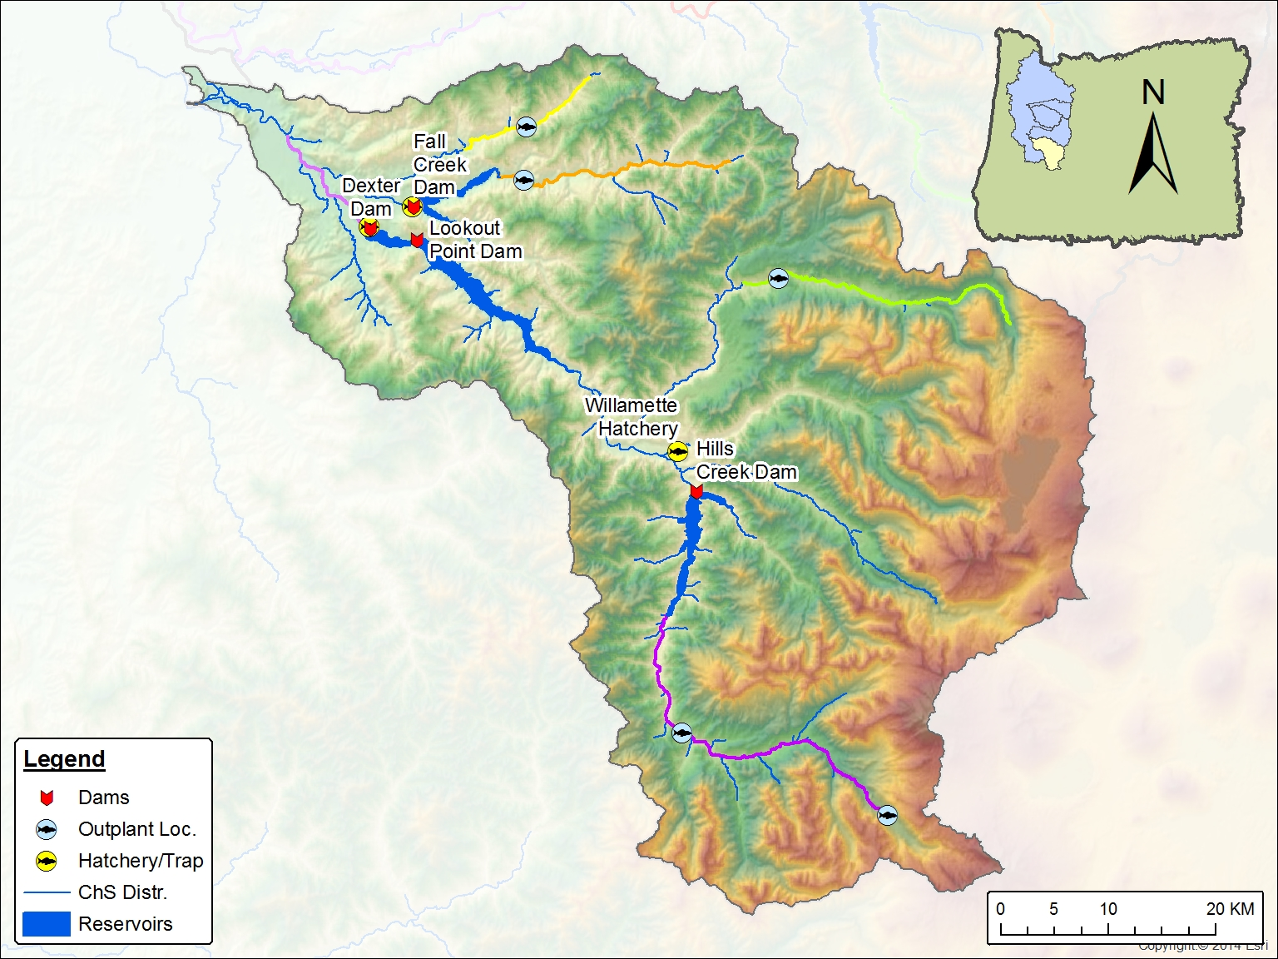
Fall Cr
Redds: 24
PSM: 71% (12/17)
pHOS: 9% (3/32)
Below Dexter
Redds: 25
PSM: 85% (41/48)
pHOS: 59% (63/107)
N Fk Mid Fk
Redds: 140
PSM: 11% (10/94)
pHOS: 99% (1/81)
Mid Fk above Hills Cr
Redds: 83
PSM: 92% (56/61)
pHOS: 97% (106/109)

Slide 23
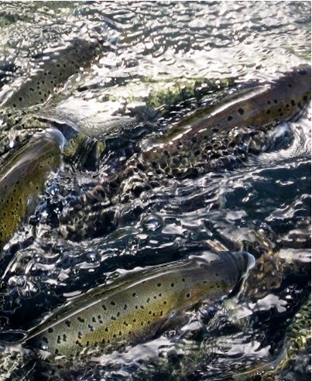
Questions?

Slide 24
 |  | MCK | CFW
Fishery Sampling | OBS | 67 | 23
Spawning Ground Surveys | OBS | 23 | 4 |  | G(adj) | 1.80
 | ADJ EXP | 20 | 7 |  | P-value | 0.179
Hatchery Sampling | OBS | 492 | 78 |  | G(adj) | 48.11
 | ADJ EXP | 424 | 146 |  | P-value | 0.000
*Expected based on fishery catch

